Slide 1

Netflix Data Analysis Project
Kottangi Charan
APPLY_1755242449689edfd14722a

Slide 2

PROBLEM STATEMENT
Understand growth in movies and TV shows, popular genres, and country-level production trends.
Analyze Netflix data to identify trends and patterns in its content library from 2008 to 2021.
Provide strategic insights into how Netflix’s content strategy evolved over time.

Slide 3
Project Description
This project performs Exploratory Data Analysis (EDA) on Netflix’s global content dataset.
It examines data related to titles, release years, countries, directors, genres, and ratings.
The goal is to uncover shifts in content production, audience preferences, and genre dominance.
Data cleaning, wrangling, and visualization were used to extract actionable insights.

Slide 4

WHO ARE THE END USERS?
Netflix Strategy Teams – to assess content performance trends over time.
Media Analysts – to study entertainment consumption patterns.
Content Creators – to understand what genres attract global audiences.
Viewers – to explore evolving Netflix catalog and preferences.

Slide 5

Technology Used
Python (Pandas, NumPy) for data preprocessing and manipulation.
Matplotlib and Seaborn for visual analysis of content trends.
Jupyter Notebook for development and exploratory research.
Dataset cleaning, type conversions, and missing value handling.

Slide 6
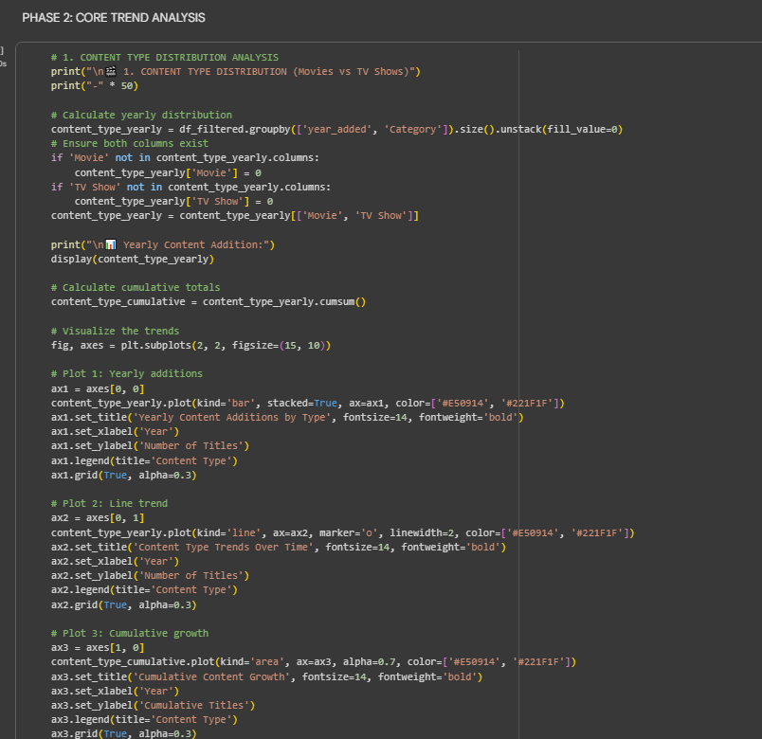
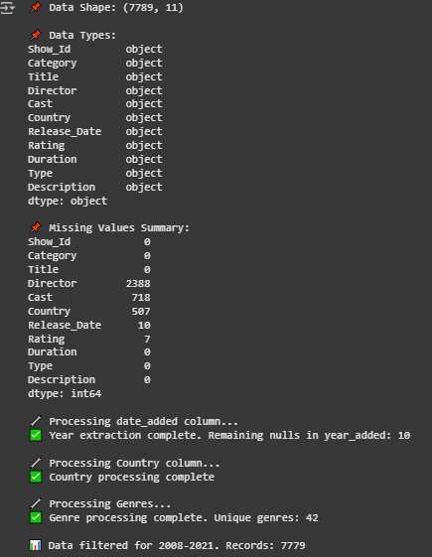
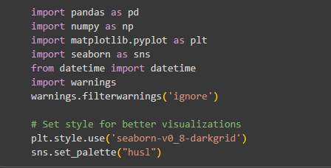
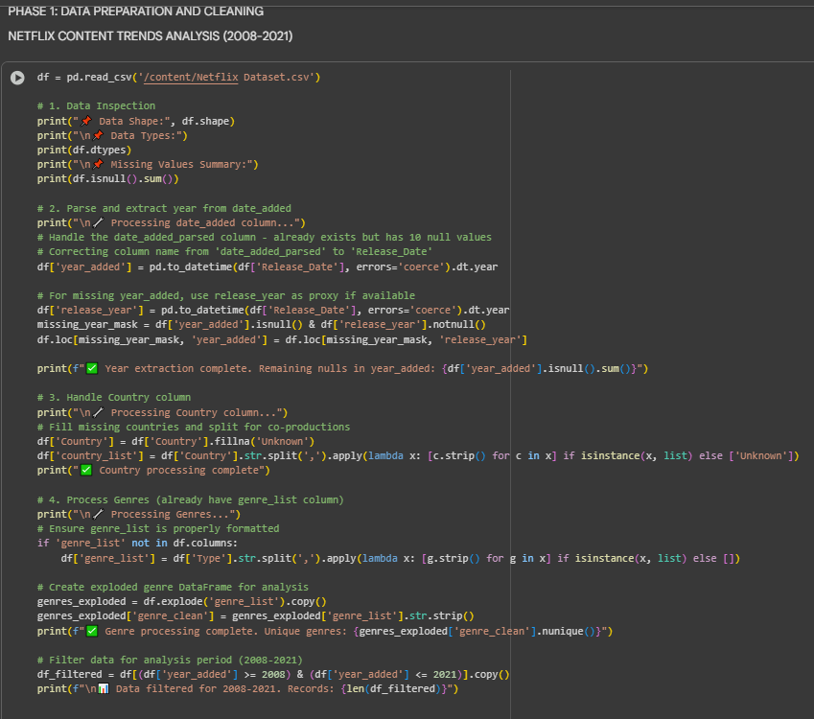
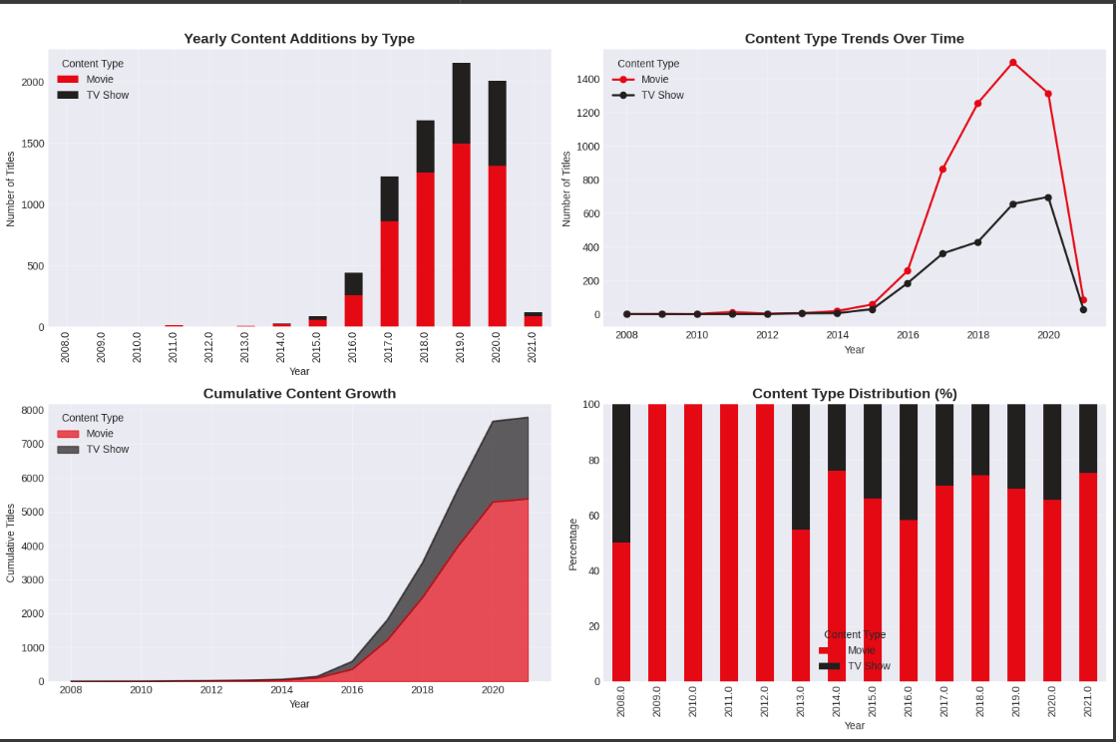
RESULTS1

Slide 7
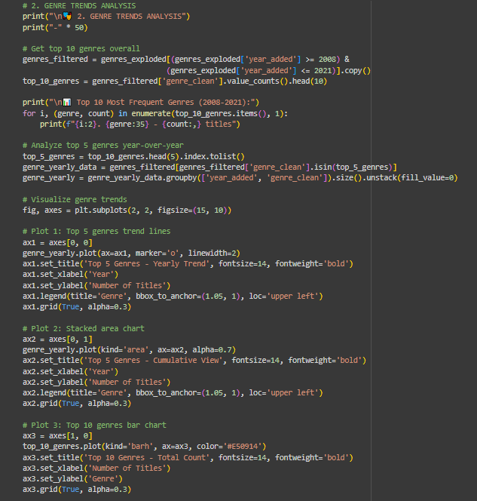
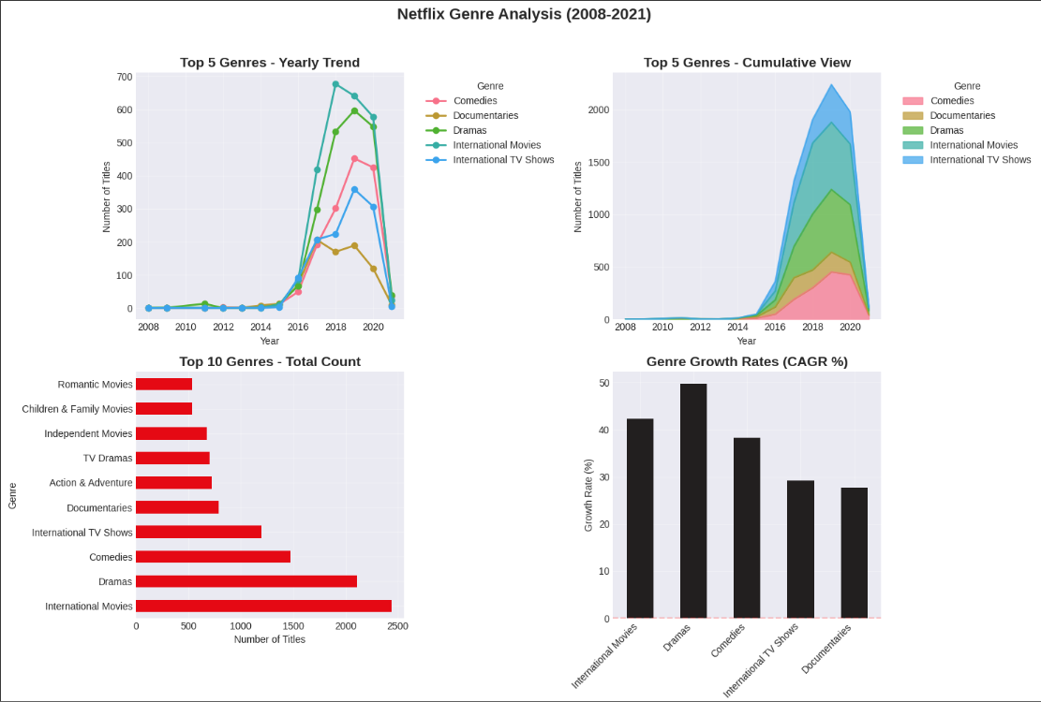
RESULTS2

Slide 8
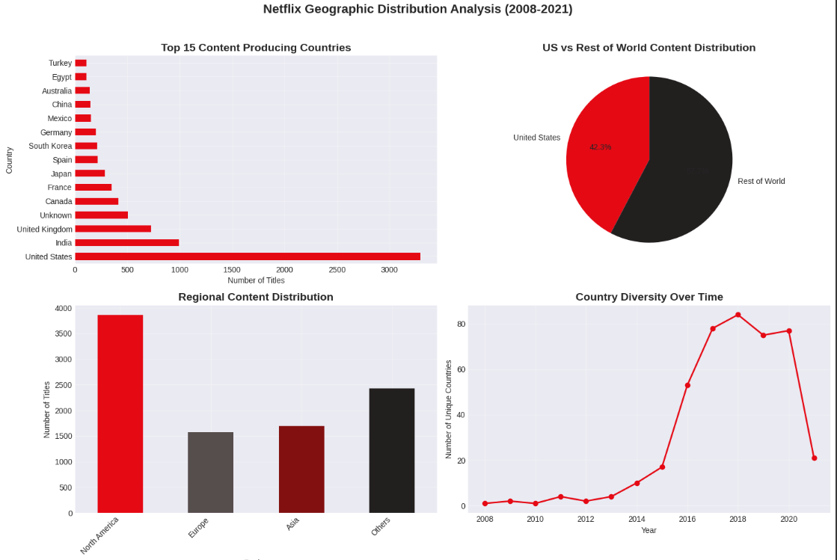
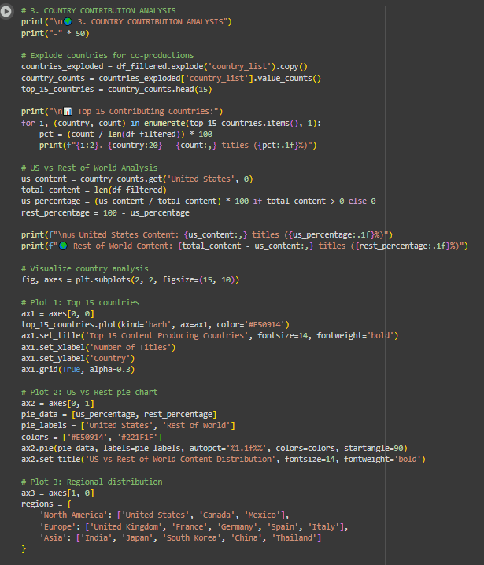
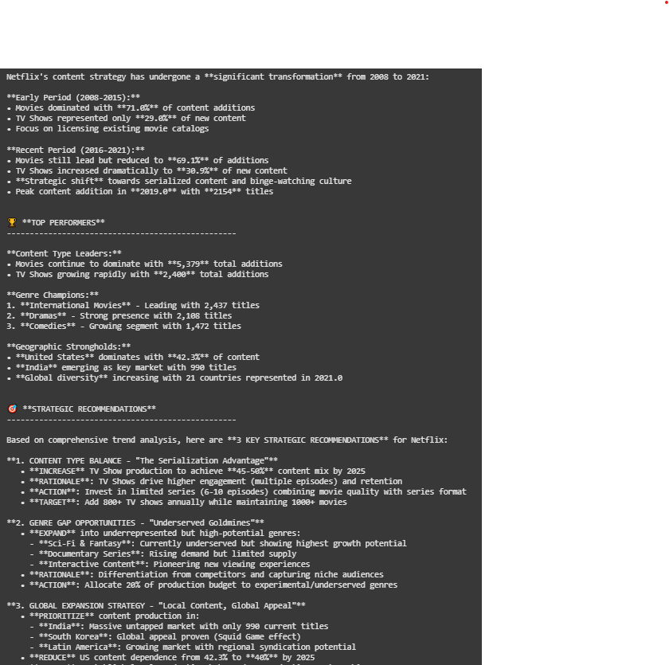
RESULTS3

Slide 9
GitHub repository
https://github.com/kottangicharan/VOIS_AICTE_Oct2025_MajorProject_Kottangi_Charan.git

Slide 10
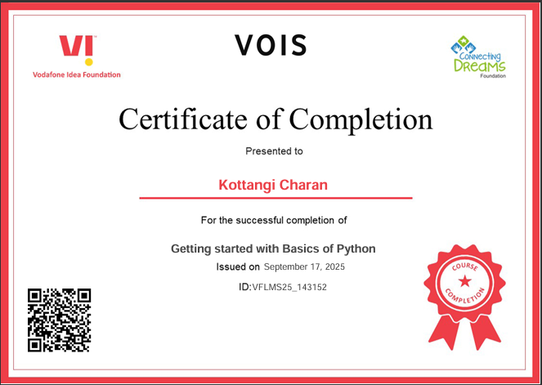
Getting started with Basics of Python Certificate
[Paste your Certificate Here]

Slide 11
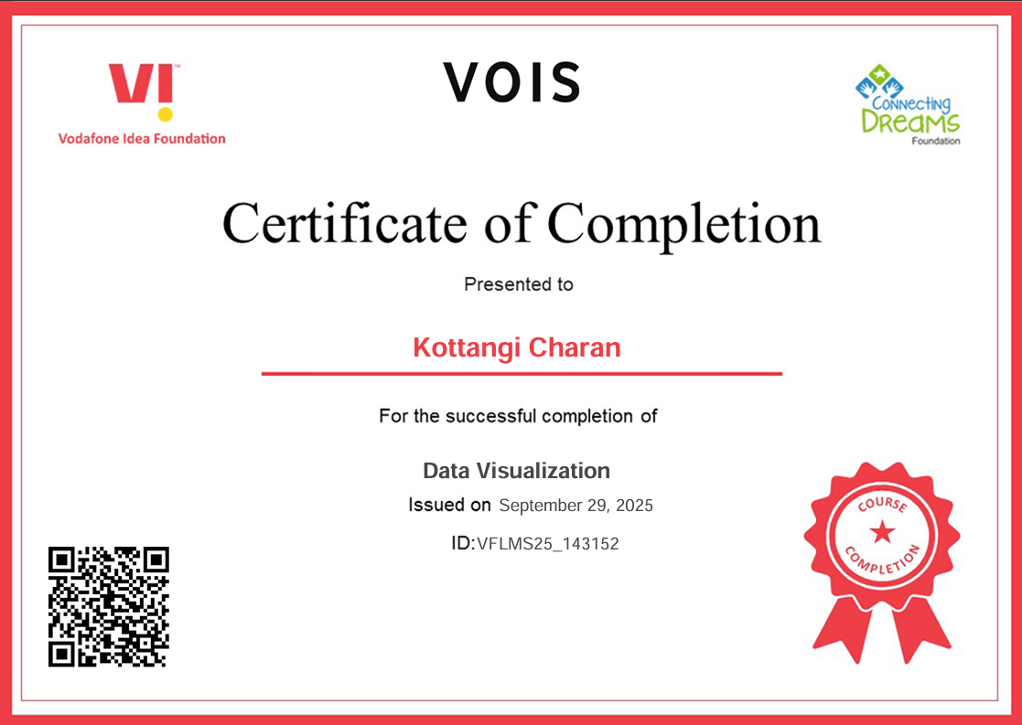
Data Visualization Certificate
[Paste your Certificate Here]

Slide 12
Thank you
Presented by: Kottangi Charan
Project: Netflix Data Analysis
Platform: AICTE Internship | VOIS Program 2025
Thank you for your time and attention!
.
.

